Slide 1
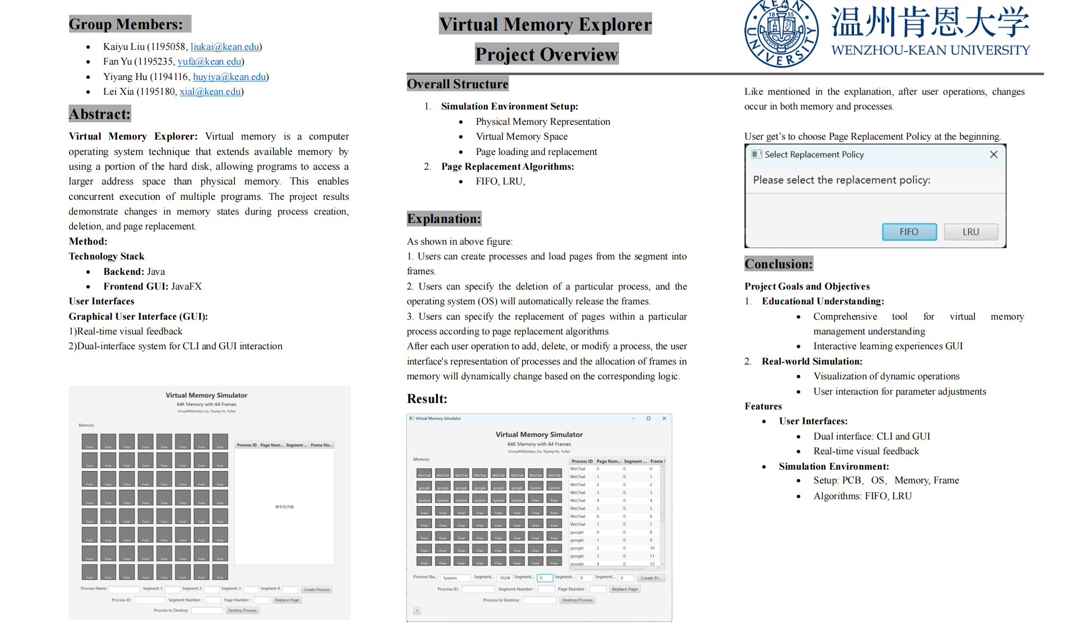
Poster

Slide 2
Virtual Memory
Overview:
Technique: Virtual memory extends available memory, utilizing a portion of the hard disk.
Purpose: Allows programs to access a larger address space than physical memory.
Benefit: Enables concurrent execution of multiple programs.
Project Focus:
Demonstrate Changes:
Memory states during process creation, deletion, and page replacement.

Slide 3
Least Recent Use (LRU)
Definition:
LRU is a predictive maintenance metric estimating the time a system will remain operational.
Key Points:
Purpose:
Predict when a system or component is likely to fail.
Facilitates proactive maintenance to minimize downtime.
Calculation:
Based on historical data, sensor readings, or predictive models.
Often expressed in units of time (hours, days).
Significance:
Enhances equipment reliability.
Optimizes maintenance schedules.

Slide 4
First-In-First-Out (FIFO)
Definition:
FIFO is a method for organizing and manipulating data structures, where the first element added is the first one to be removed.
Key Points:
Principle:
Elements are processed in the order they are added.
Application:
Commonly used in queues and buffers.
Ensures fairness and sequential processing.
Advantages:
Simple implementation.
Predictable order of processing.
Limitations:
May not be optimal for all scenarios.
Not suitable for scenarios requiring prioritization.

Slide 5
Virtual Memory
Method:
Technology Stack:
Backend: Java
Frontend GUI: JavaFX
User Interfaces:
Graphical User Interface (GUI):
Real-time Visual Feedback
Dual-interface System:
CLI and GUI Interaction

Slide 6
Code Explanation
Main.java
Entry point of the application.
Checks Java version, launches application. Supports Java 11+, implying potential JavaFX usage for GUI.
Memory.java
Simulates the memory class.
Initializes memory with frames (Frame class). Manages memory allocation at the frame level.
MemorySimulatorGUI.java
Manages the GUI.
Uses JavaFX. Includes controls, layout for user interaction. Visualizes virtual memory state.

Slide 7
Code Explanation
OS.java
Represents the operating system's role in memory management.
Defines constants (memory size, page size). Crucial for simulating OS memory management (paging, segmentation).
PCB.java
Represents Process Control Block.
Manages process-specific data (ID, segment table). Essential for tracking and managing processes in memory.
Shell.java
Provides a command-line interface.
Commands for process creation, destruction, memory usage display. Facilitates user interaction with the memory management system.

Slide 8
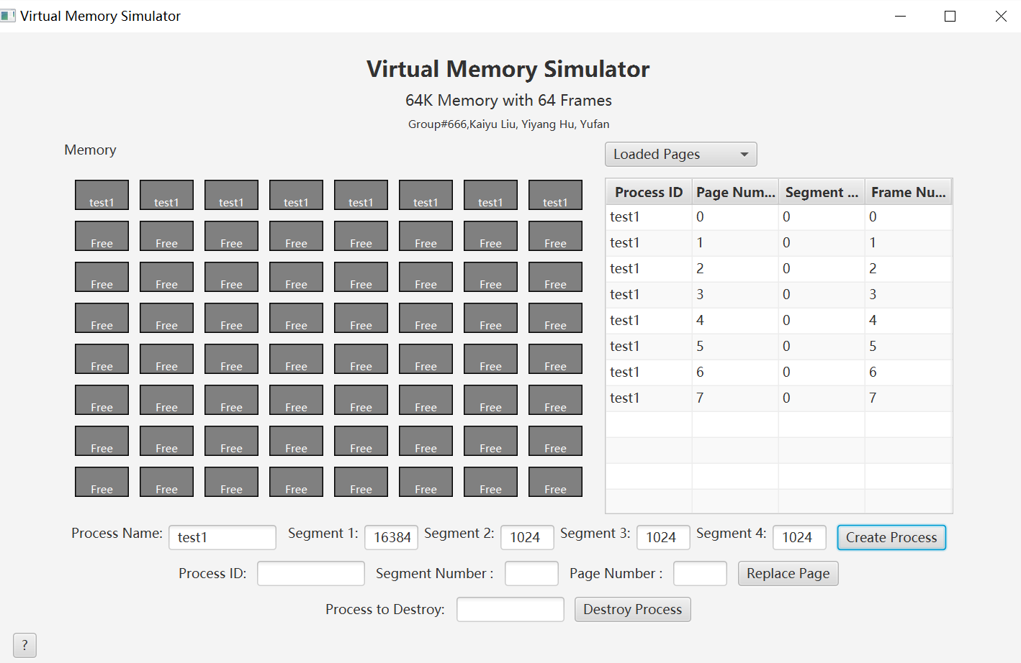
GUI(Process Creation)

Slide 9
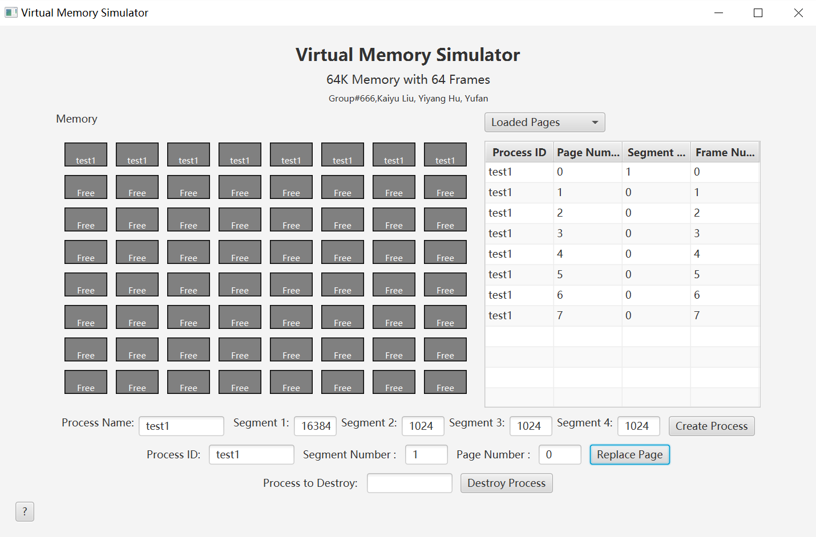
GUI(Page Replacement)

Slide 10
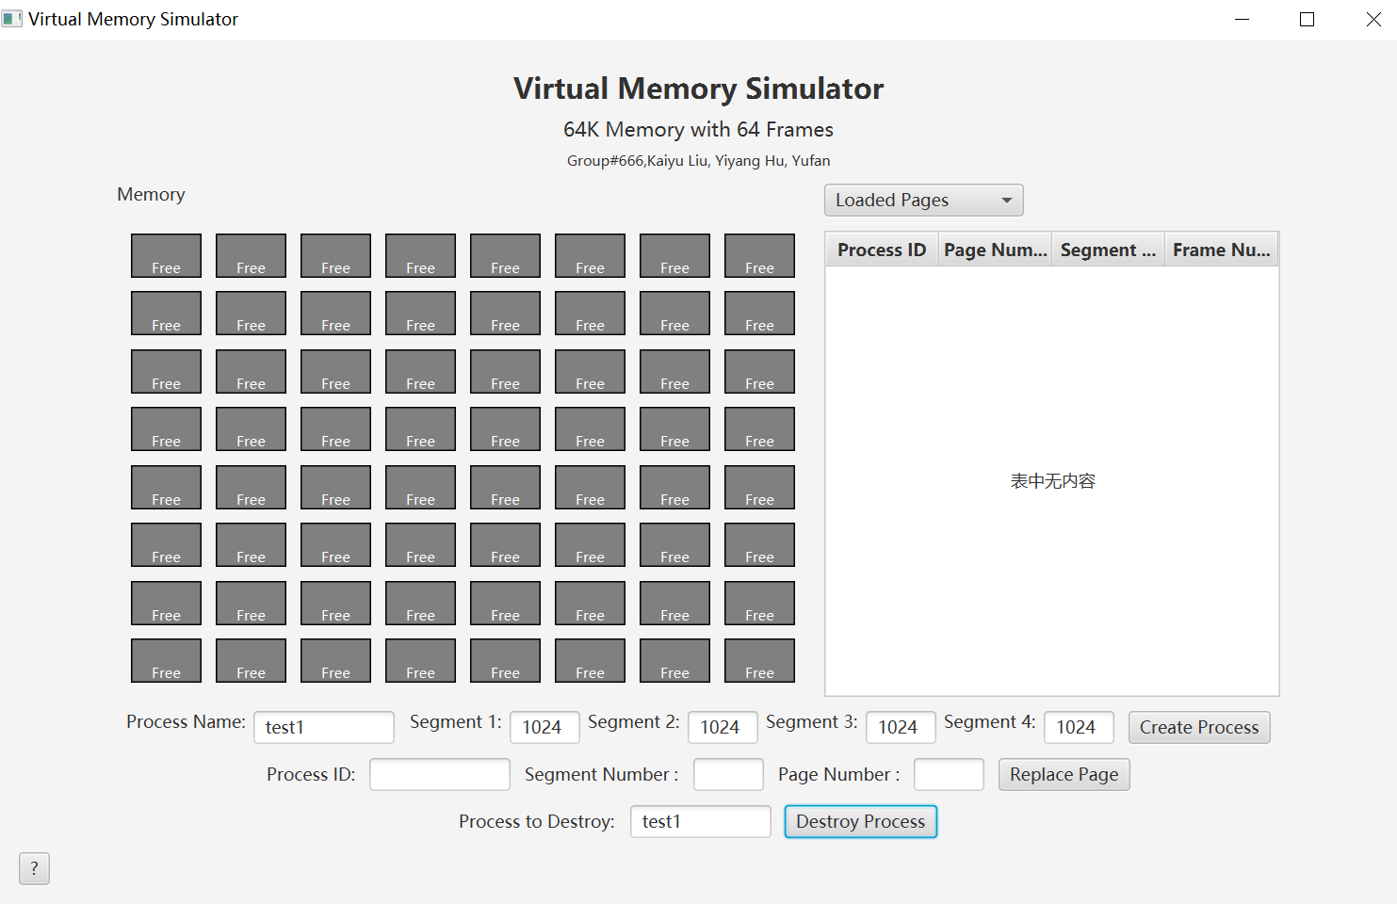
GUI(Process Destruction)

Slide 11
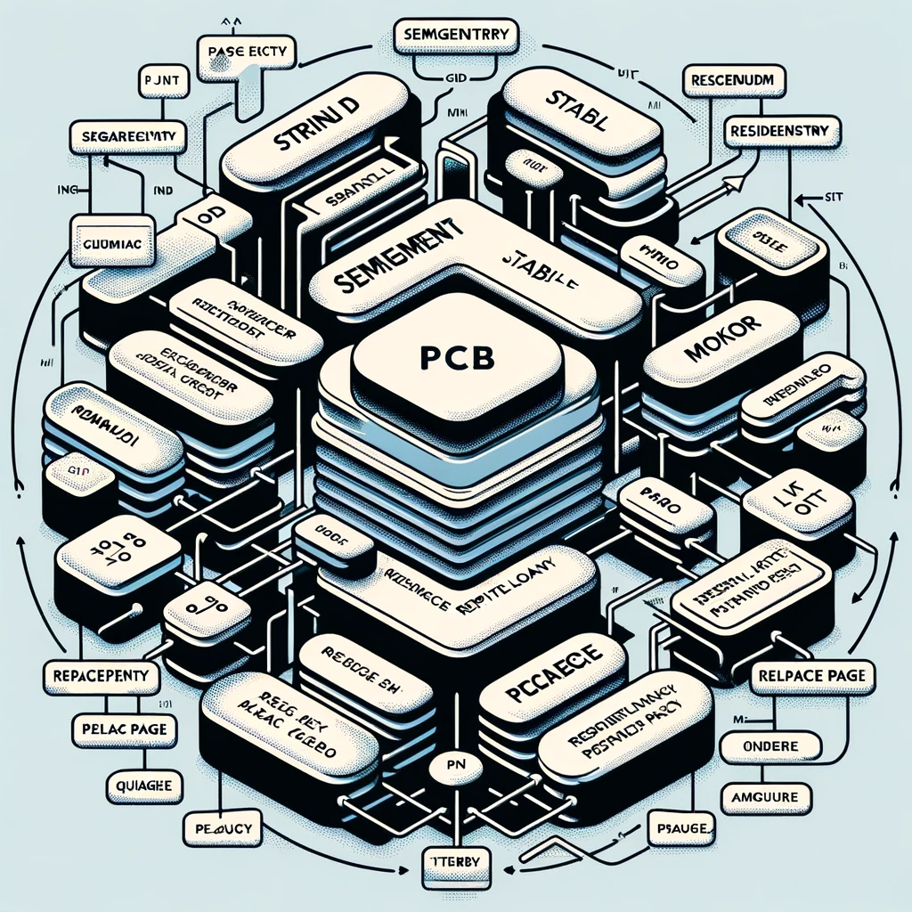
PCB Class
Attributes:
memory: Static reference to Memory object (shared memory model).
id: Unique process identifier.
STable: Array of SegmentEntry objects (segment table).
residentSetCount: Count of pages in the resident set.
residentSet: Array of frame numbers in the resident set.
policy: Page replacement policy.

Slide 12
PCB Class
loadQueue: Queue to track page loads (FIFO policy).
Constructor:
Initializes process ID, segment table, and page replacement policy.
Fills segment table based on segment sizes.
Calculates resident set count adhering to the max resident set number.
Static Method - setMemory:
Sets Memory object reference for PCB class (shared memory model).

Slide 13
Nested Classes: SegmentEntry and PageEntry
SegmentEntry:
Represents a memory segment.
Attributes: segmentNum, segmentSize, PTable (Page Table).
Constructor calculates page table size.
PageEntry:
Represents a page in a segment.
Attributes: pageNum, load, frameNum, usedTime (LRU), protection settings.
Methods setLoad and setUnload manage page loading/unloading.

Slide 14
Functionality :
PCB class and nested classes provide a comprehensive model for process representation in memory management.Facilitates tracking each process's memory usage, segment and page information, and adherence to specific memory policies.Indicates a sophisticated approach to simulating memory management at both segment and page levels, crucial for understanding modern OS memory management.

Slide 15
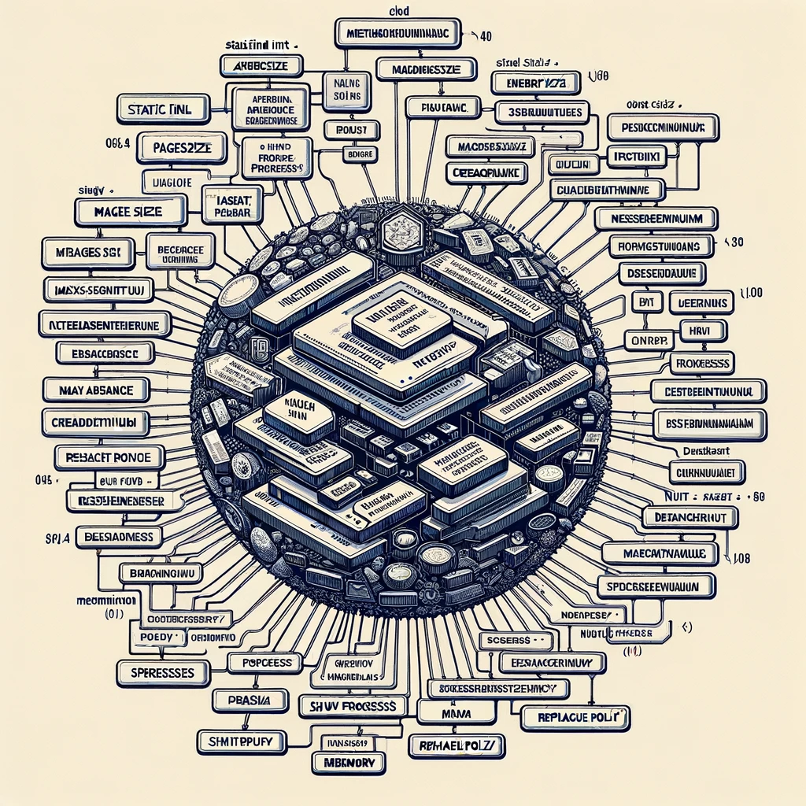
OS Class
Constants:
memorySize: Total size of memory.
pageSize: Size of each page (crucial for page-based memory management).
maxSegmentNum: Maximum number of segments a program can have.
maxSegmentSize: Maximum size of each segment.
maxResidentSetNum: Maximum number of pages in a process's resident set.
REPLACE_POLICY: Enum defining page replacement policies (FIFO, LRU).

Slide 16
OS Class
Attributes:
ReplacePolicy: Default replacement policy set to LRU.
processes: Map storing PCB objects (keyed by process ID) for all active processes.
memory: Instance of the Memory class representing simulated memory.
Constructor:
Initializes the memory object, setting it in the PCB class for a shared memory model.
Process Validation and Creation:

Slide 17
OS Class
validate: Validates legality of creating a process (checks for duplicate names, segment constraints).
createProcess: Creates a new process, allocates memory, sets up its PCB.
Process Destruction:
destroyProcess: Removes a process, frees up its memory.
Memory Management:
Methods like showMemoryUsage and PageReplace manage memory allocation and apply page replacement policies.

Slide 18
OS Class
Utility Methods:
getProcesses and getAllActivePCBs: Provide access to active processes and their PCBs.
Functionality Overview:
OS class is the central hub for managing processes and memory in the simulator.
Handles process creation and destruction, ensuring legal operations and memory allocation.
Manages page replacement policies for simulating real-world memory management.
show memory usage likely provides a detailed view of memory usage by each process.

